Slide 1
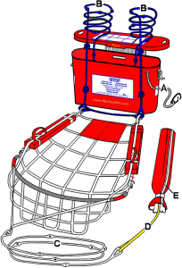
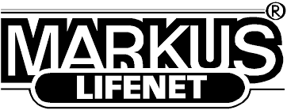
Markus Rescue Net Inspection Process
Markusnet and/or Markus Scramble-net must be inspected up to 5 years after manufacture, and every 5th year after.
Both nets must be inspected after being used for training, or in the event they are used in an MOB situation.
All inspection/use of Markusnet/ Scramble-net should be recorded in the ship’s log.
Any Markusnet/ Scramble-net used in training, should be marked as such and packed by the safety officer.
* Documents needed: 1. EYD 043-4 MS Inspection record (to be submitted), 2. LEI 330-2, and 3. LEI 333-1 *

Slide 2
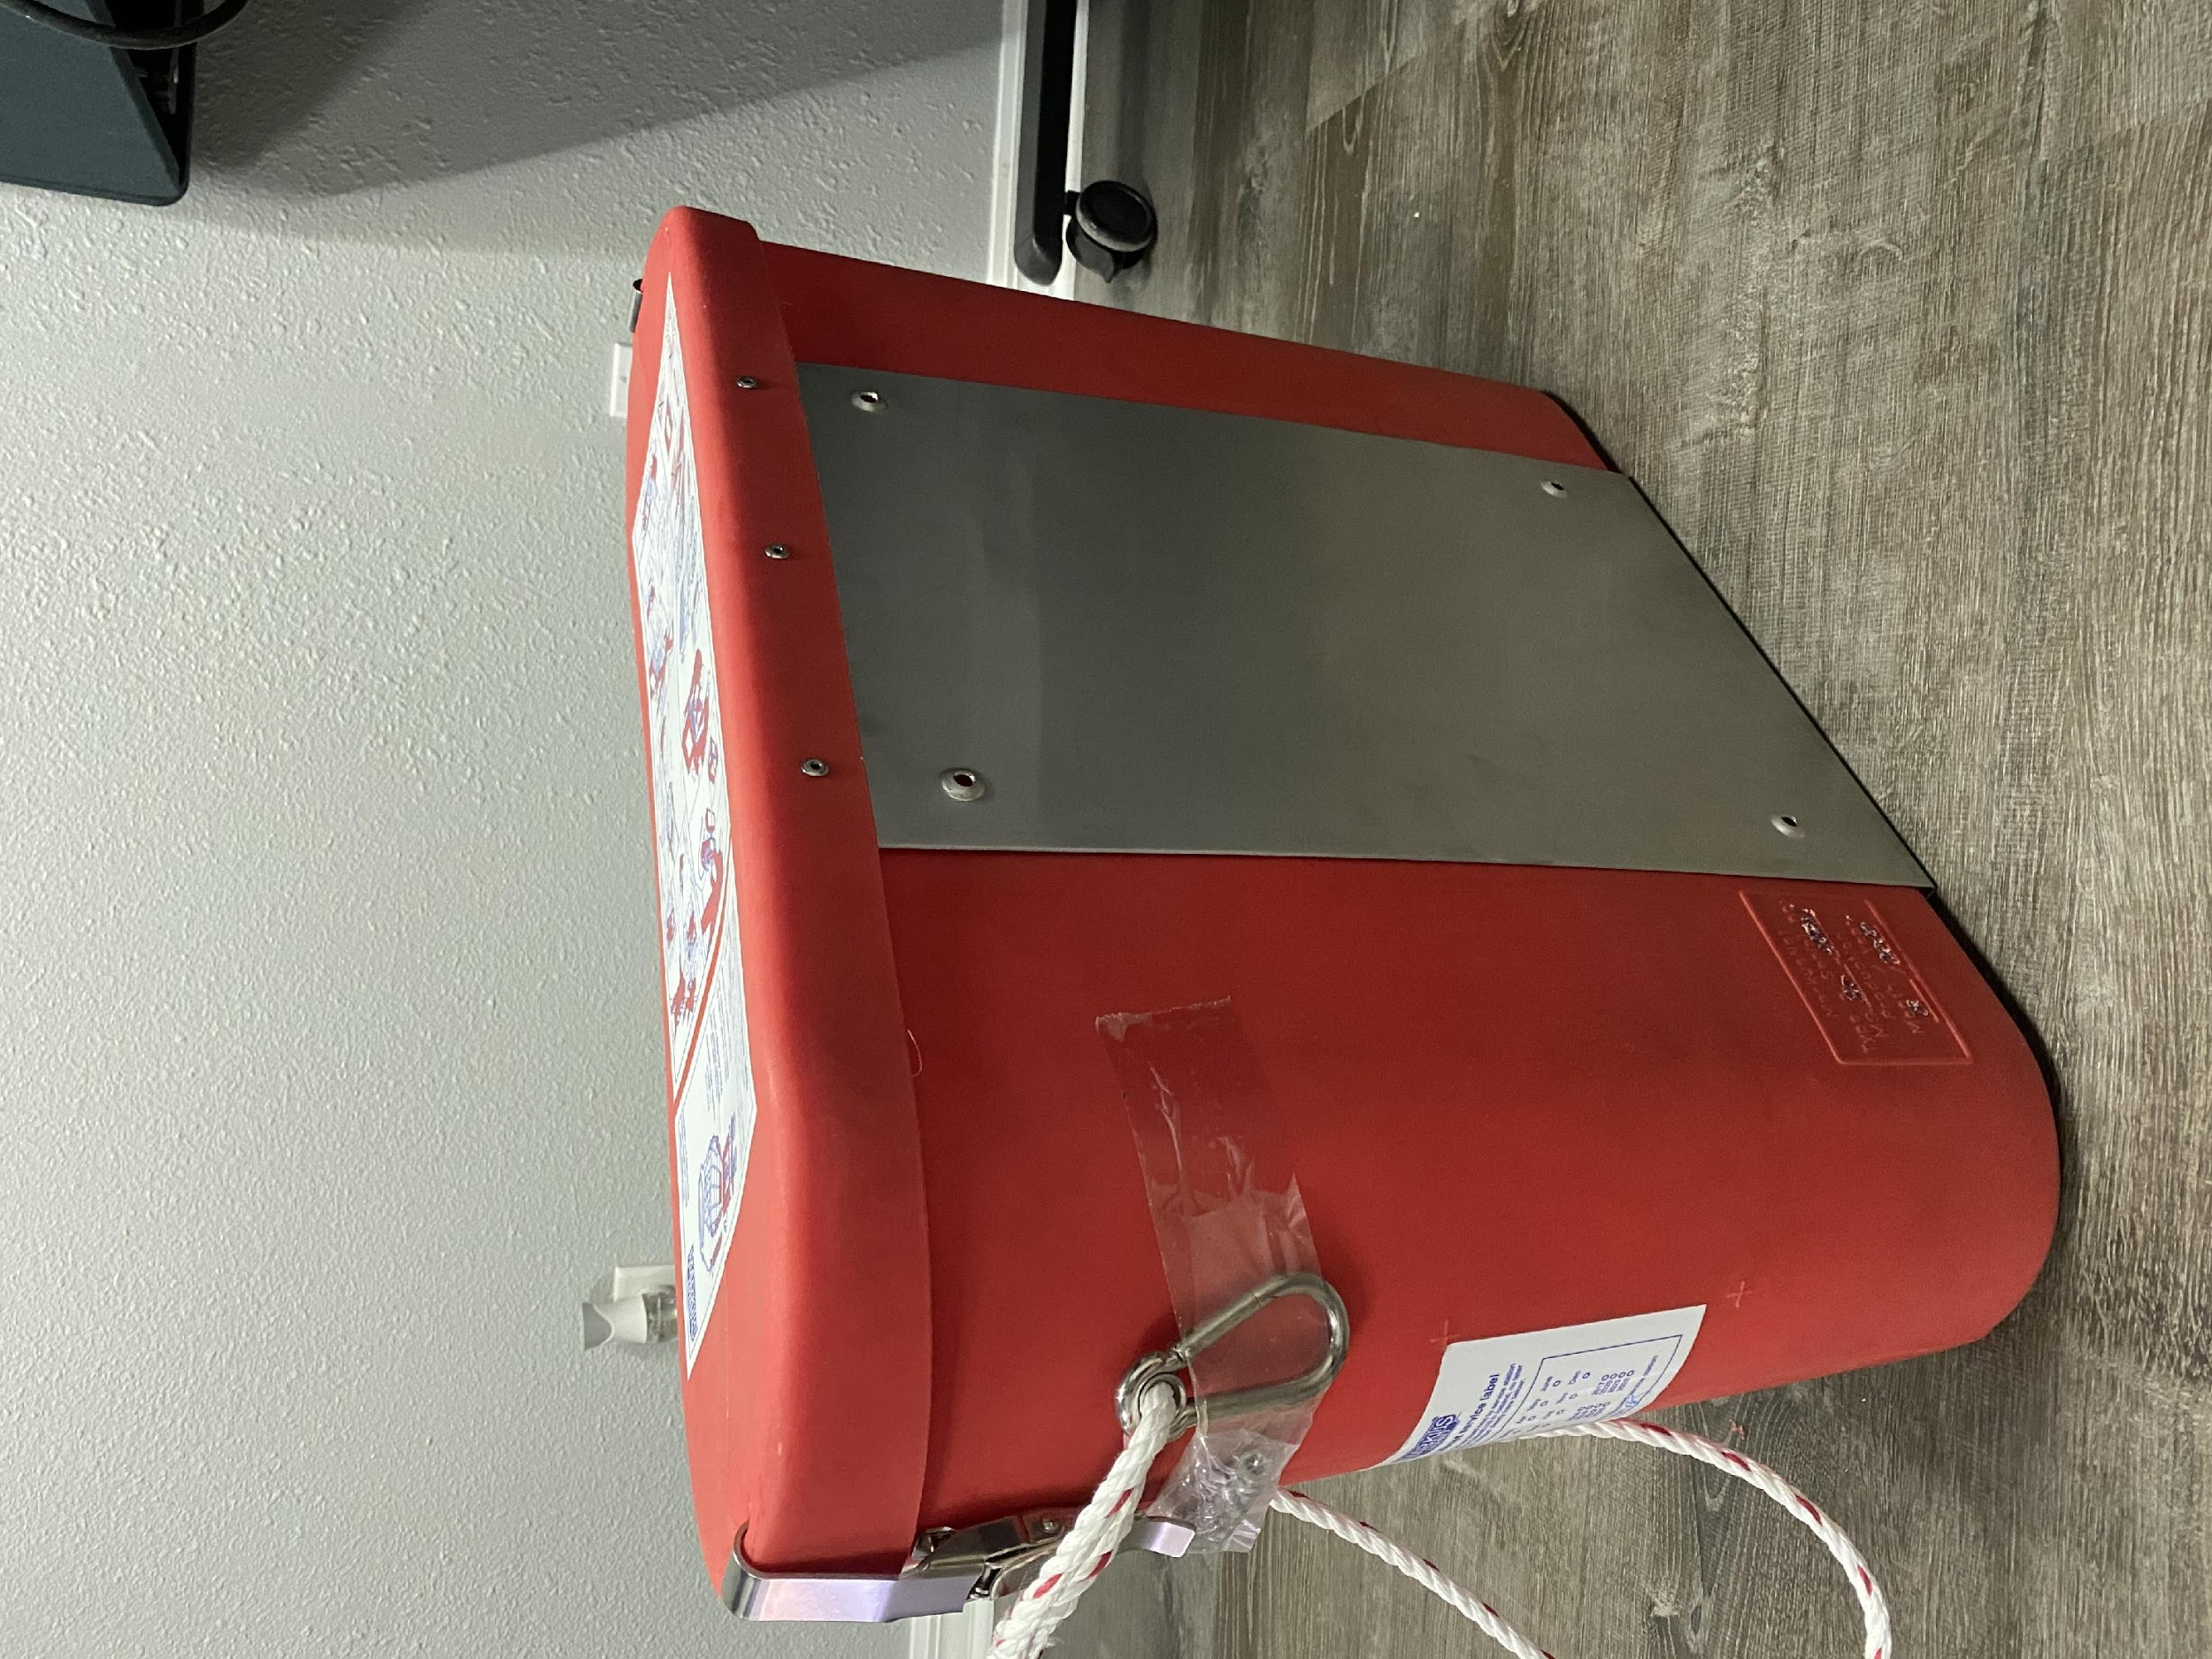
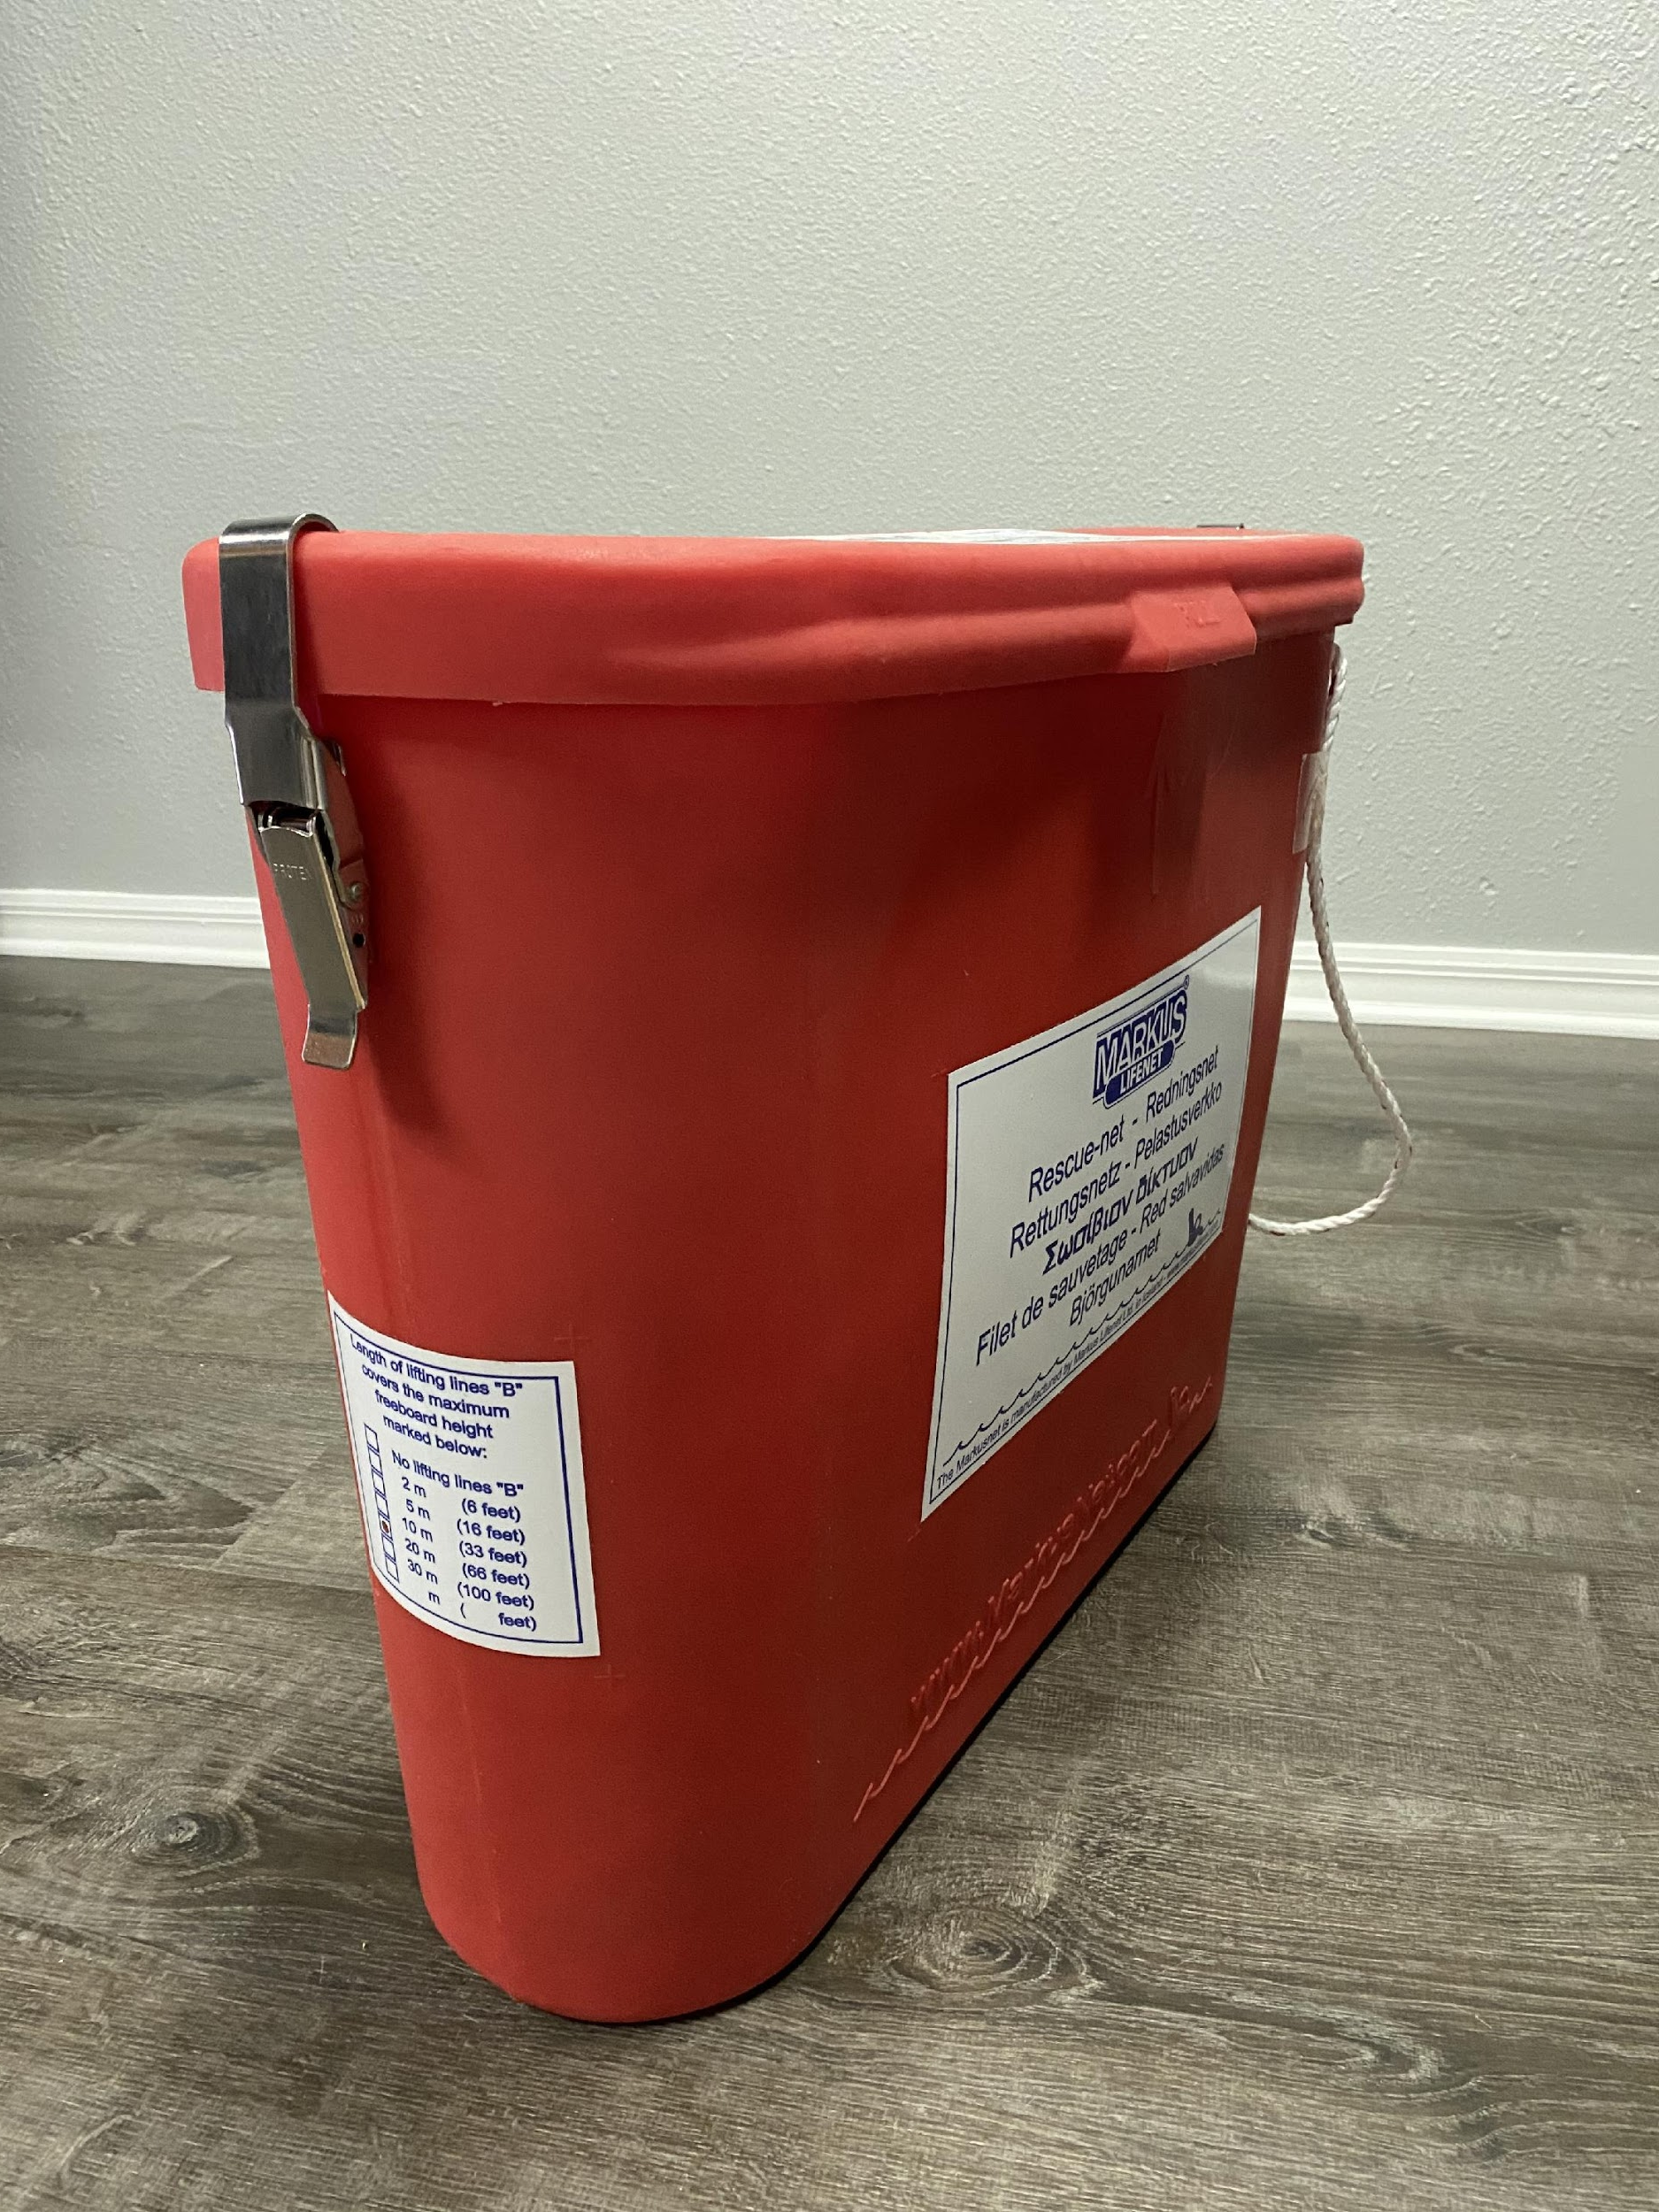
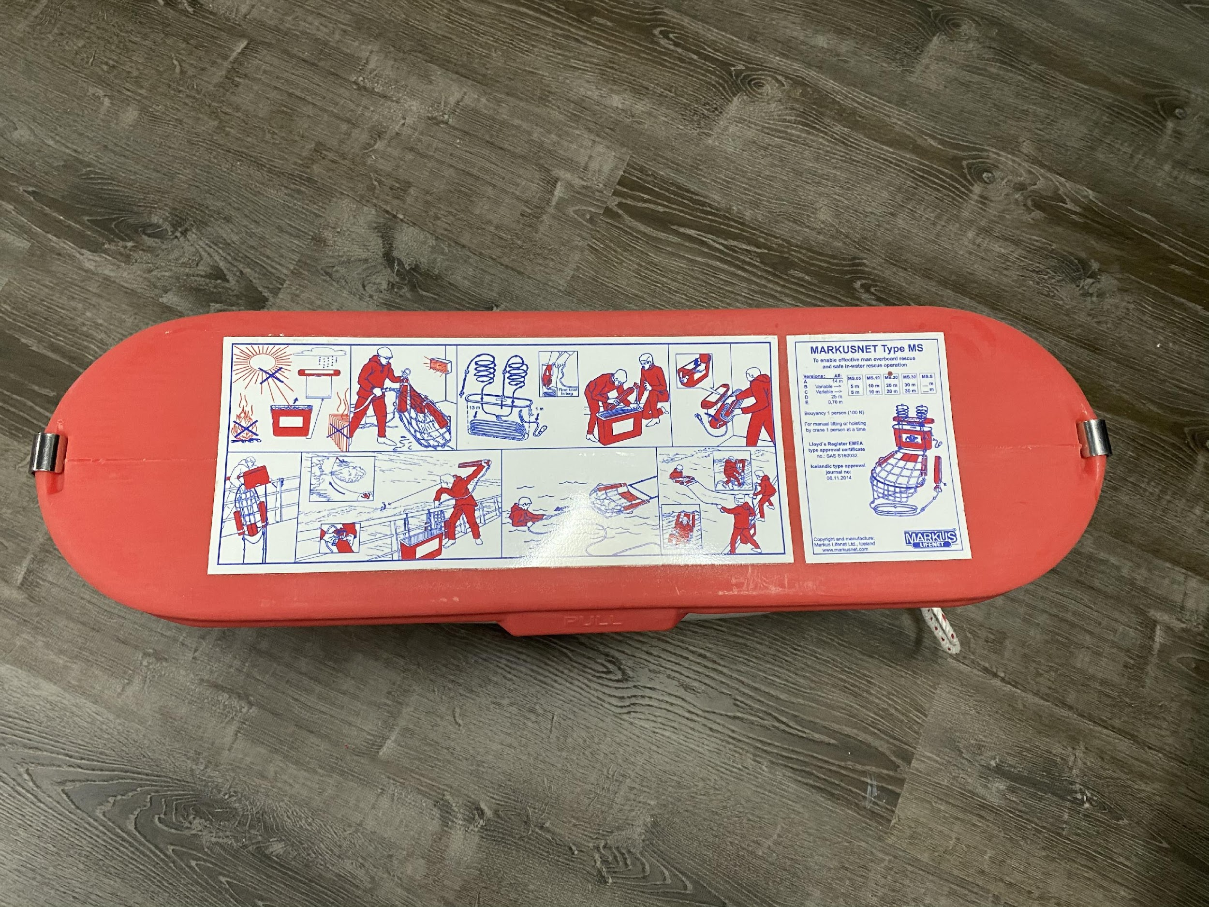
Identifying Parts to be Inspected
Markus Net Container
Description: Rigid orange/red container which contains net-structure, lift lines, and throw bag.
Identifying Damage: Damage due to impact; cracks, puncture, etc. Exterior labels not damaged; faded, torn, or missing.
Repair: Container must be replaced if damaged. - Labels can be replaced separately.
*ALL pictures to be taken and submitted with inspection paperwork*

Slide 3
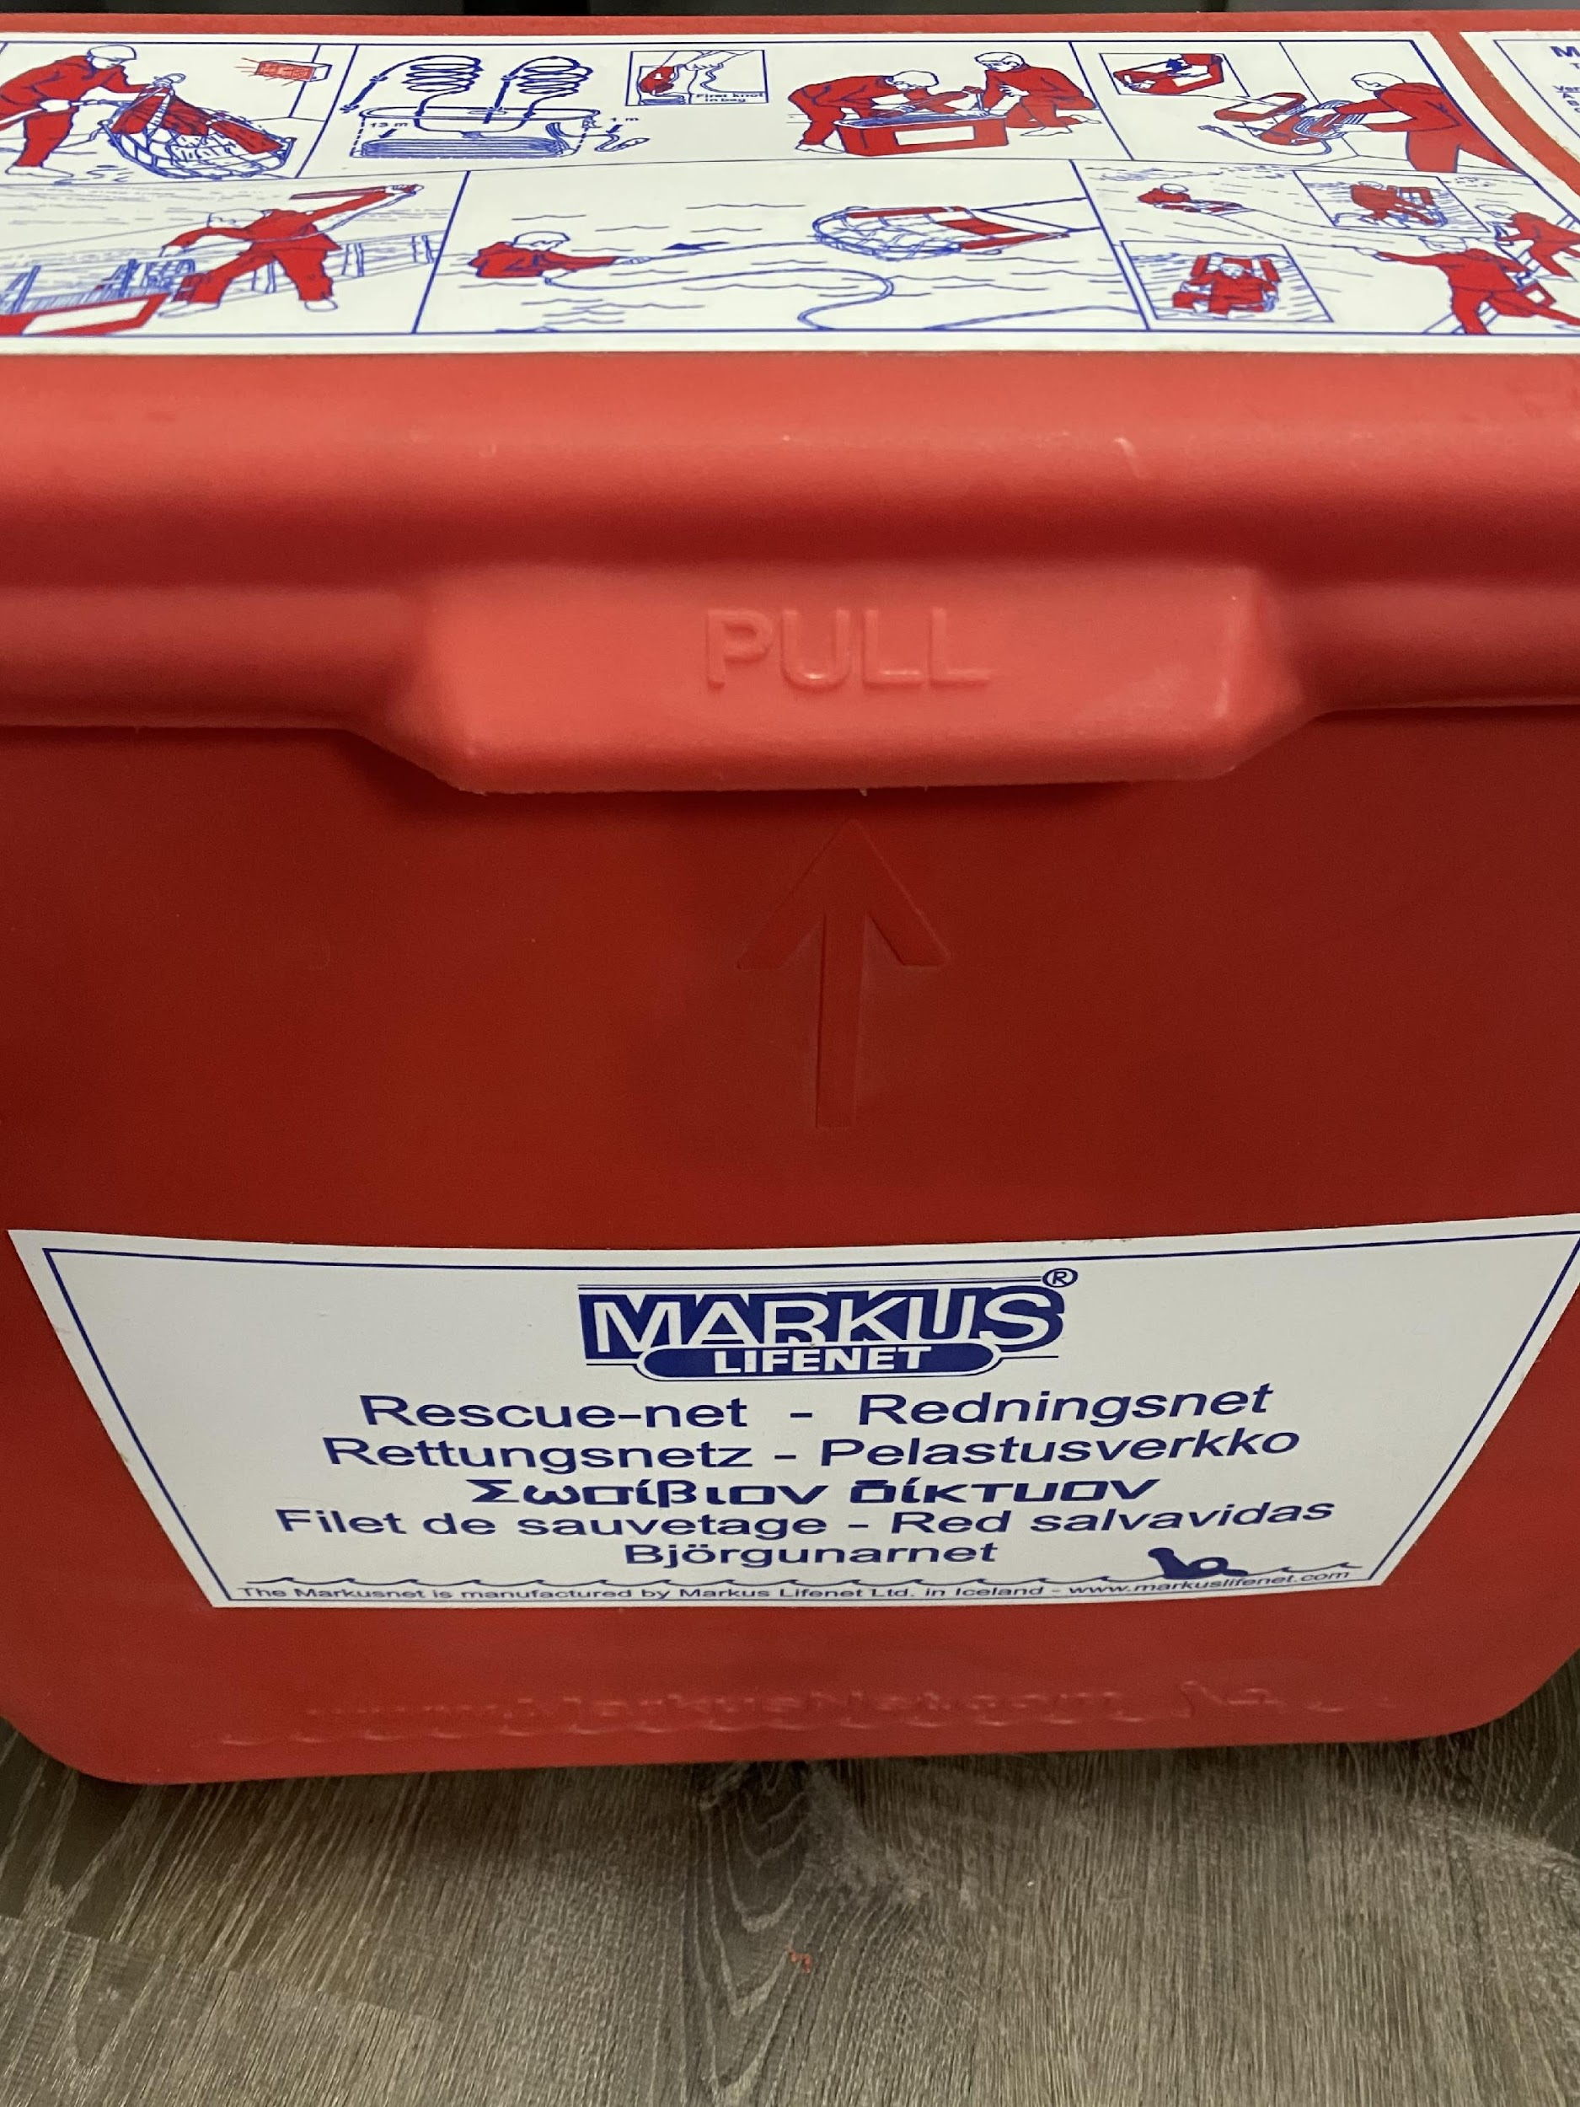
Identifying Parts to be Inspected cont.
Handle for lid
Identifying damage: Line may be frayed/broken due to sun and sea.
Repair (late model only): Replace container
New model containers will have a lift handle on lid (unless lid broken no measure necessary) Later model containers will have white line fixed to lid.
*ALL pictures to be taken and submitted with inspection paperwork*

Slide 4
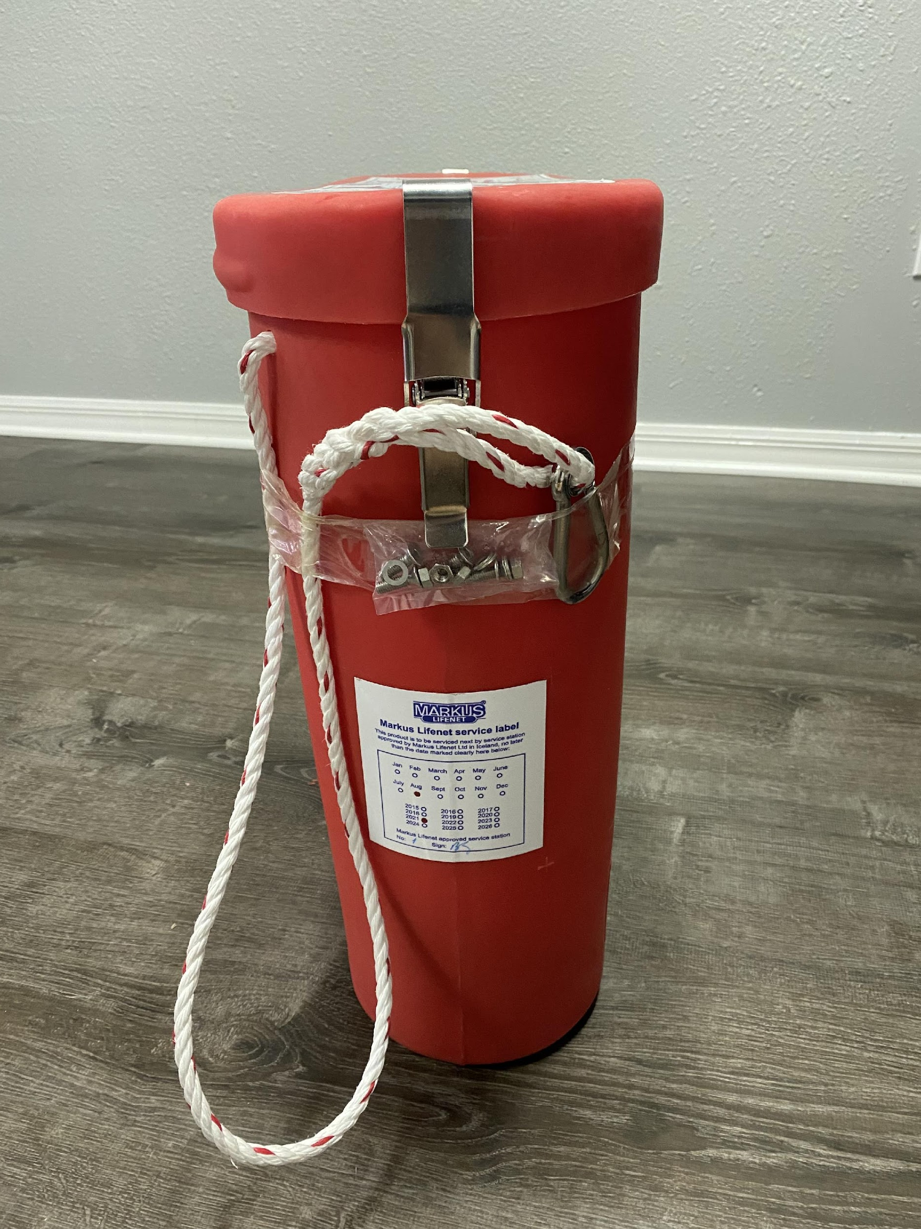
Identifying Parts to be Inspected cont.
Attachment line (outside box)
14-meter white line to attach container to vessel at rescue zone (line contained inside container)
Identifying Damage: Can be damaged due to salt/sun exposure; frayed, broken, etc.
Repair: Cut the damaged section of line and draw out new line amount; splice snap hook onto attach line.
*ALL pictures to be taken and submitted with inspection paperwork*

Slide 5
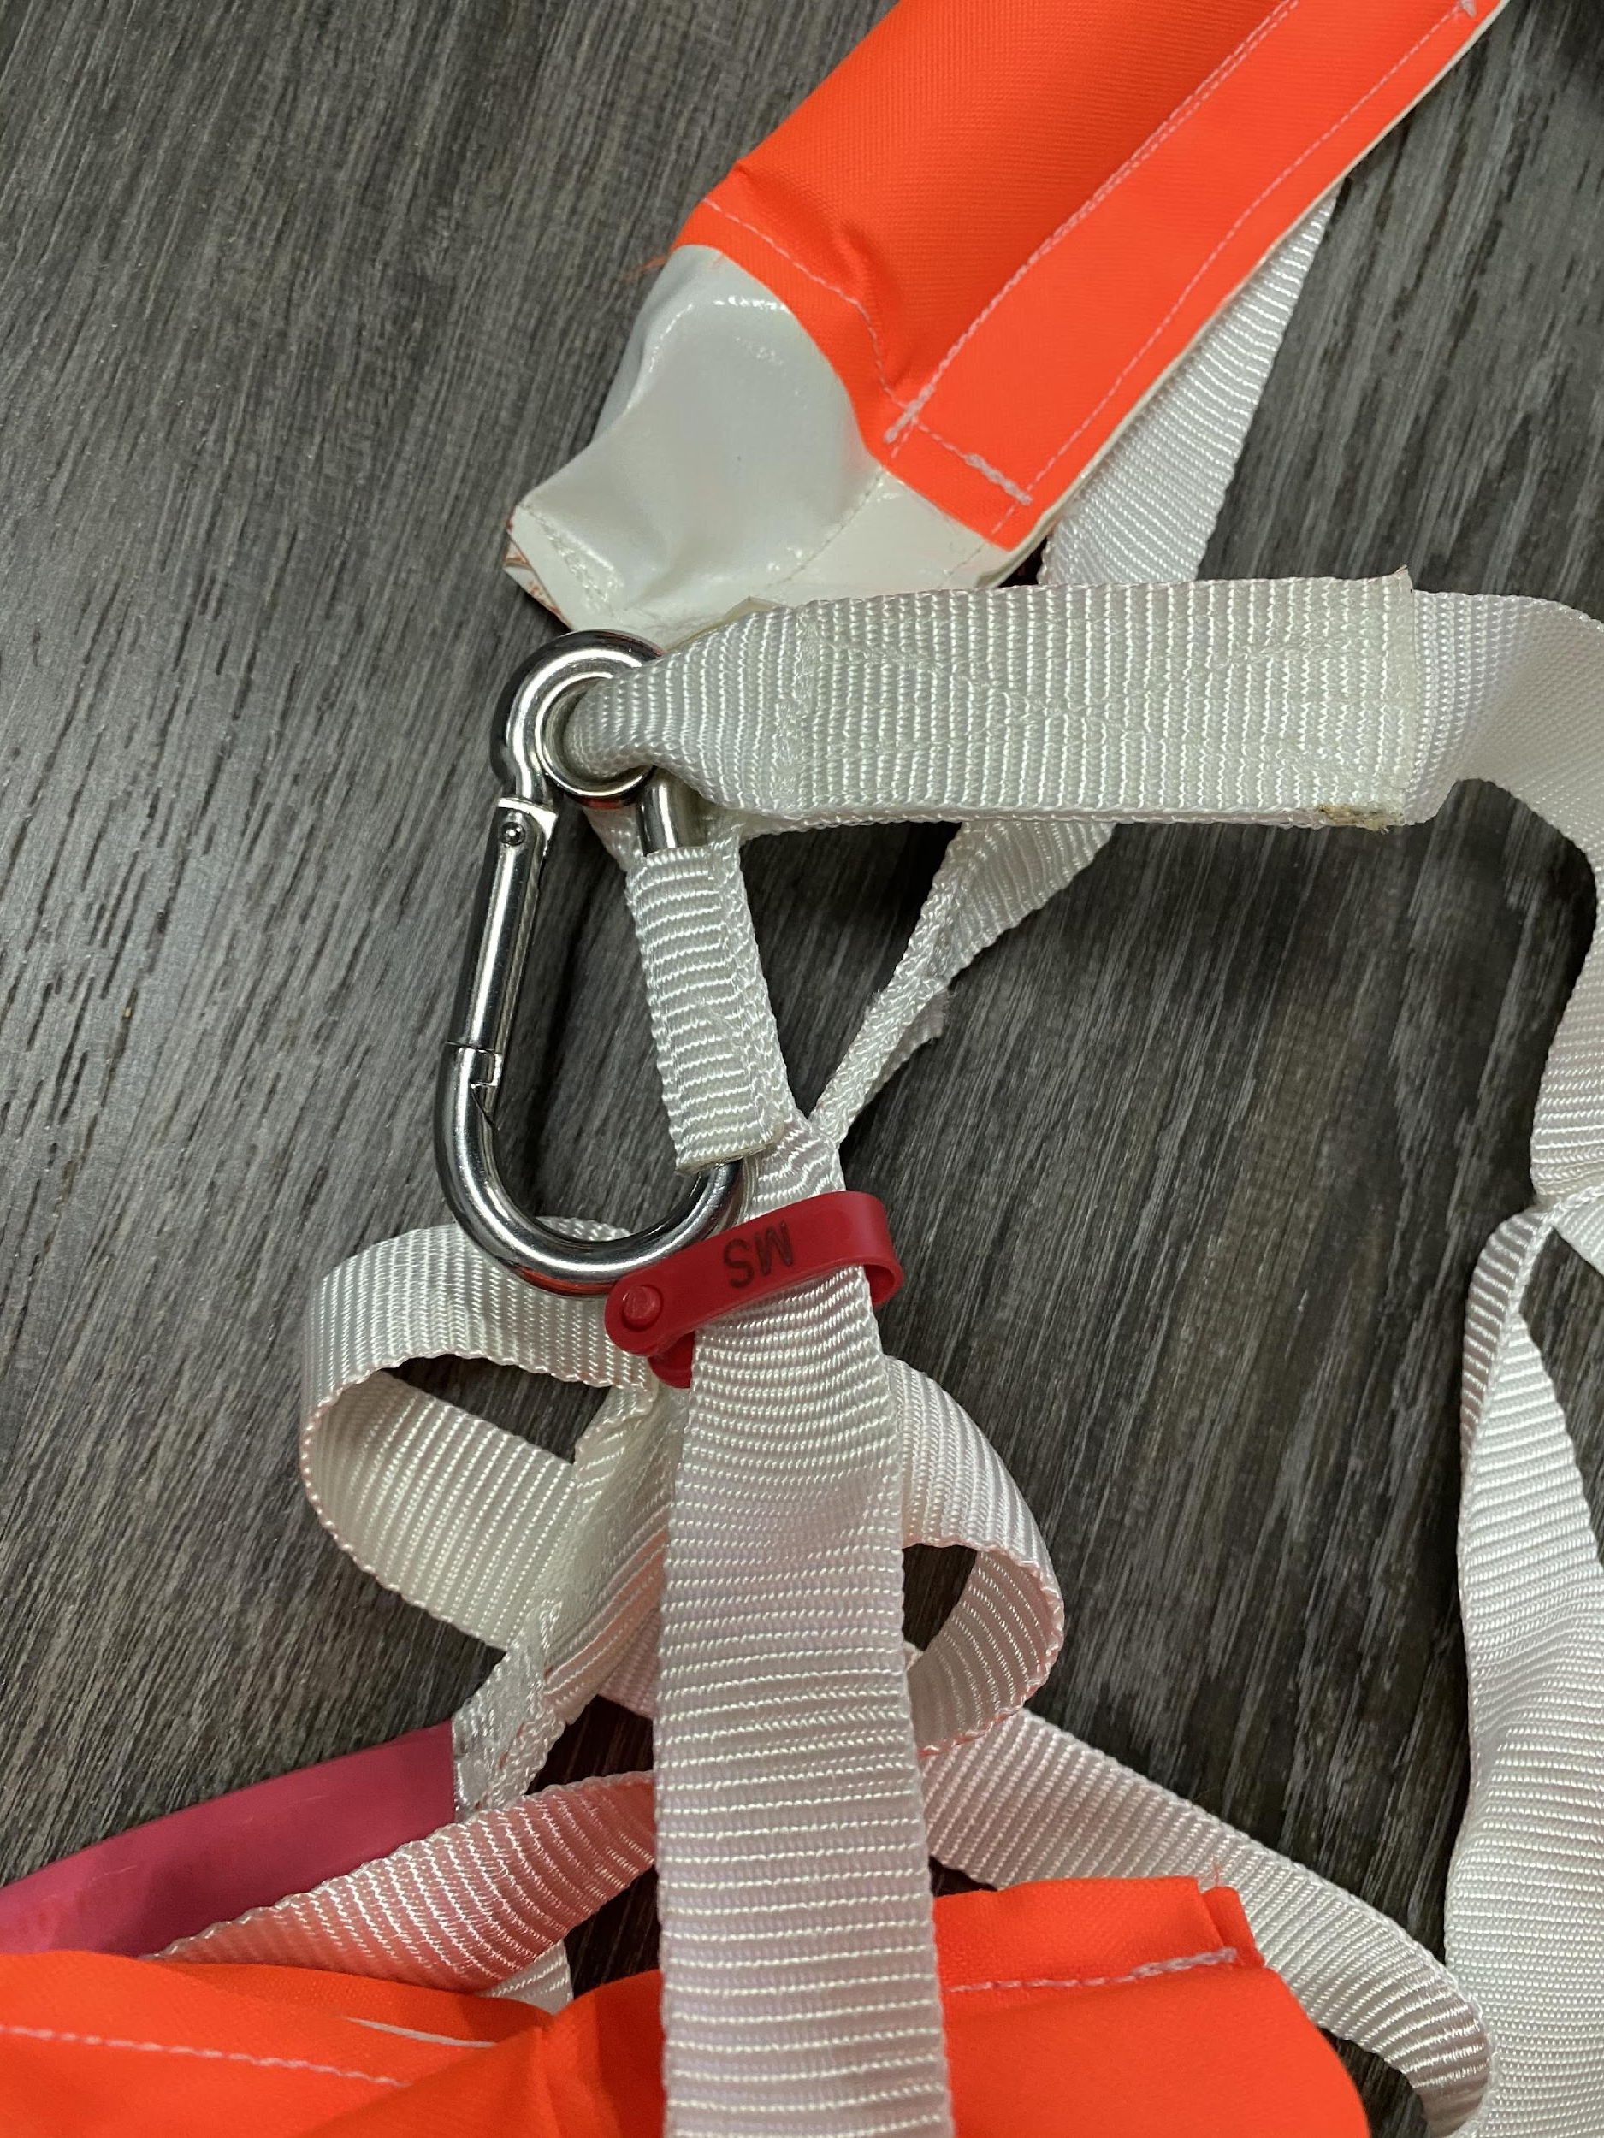
Identifying Parts to be Inspected cont.
Serial number tag
Description: Red tag located below side float.
Identifying damage: Red serial number tag must be intact.
Repair: Replace Markus life net.
*ALL pictures to be taken and submitted with inspection paperwork*

Slide 6
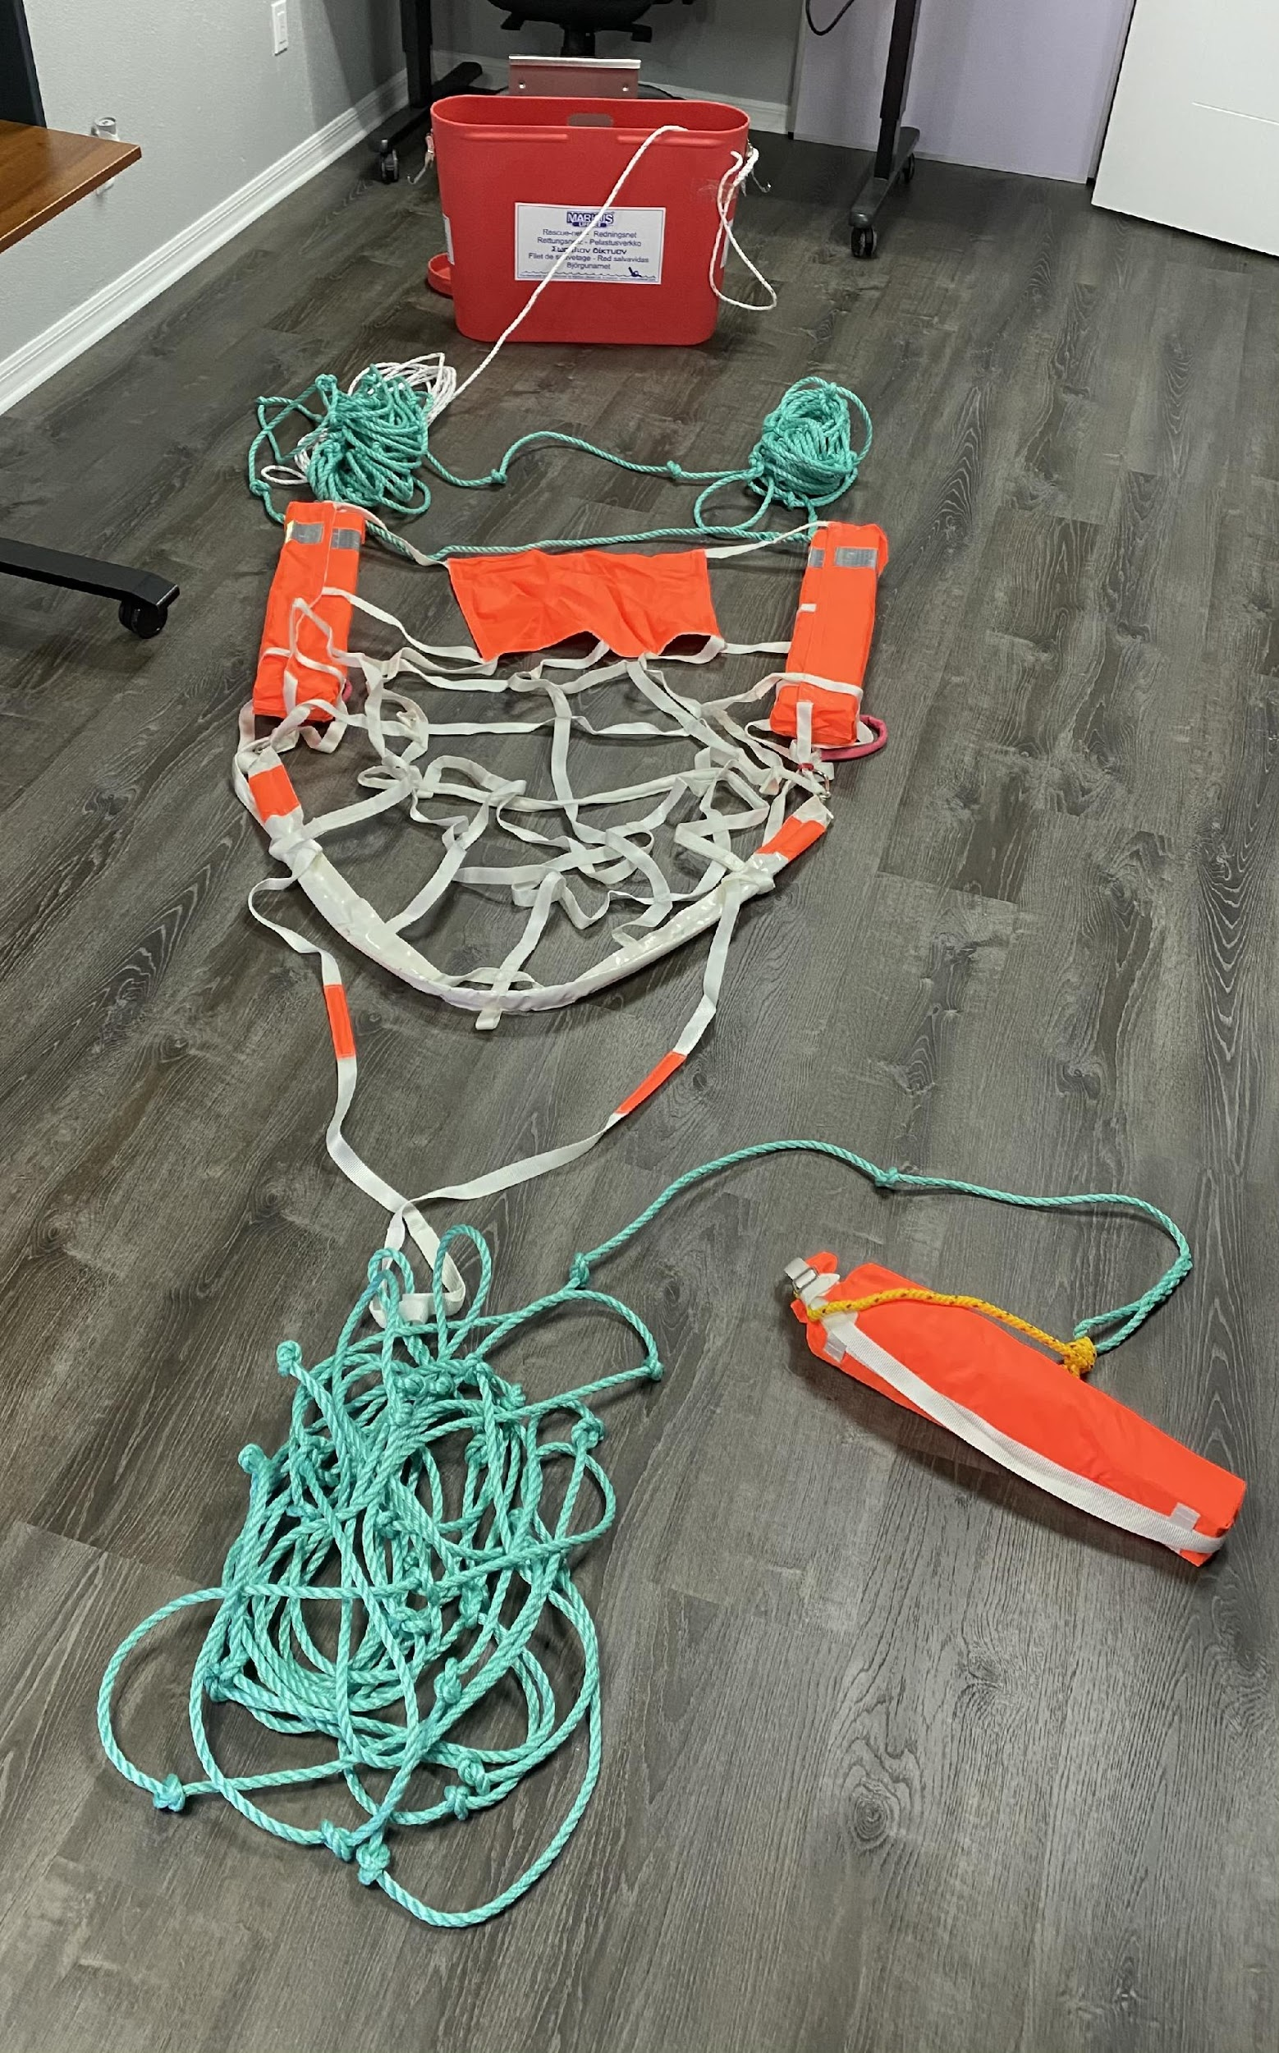
Identifying Parts to be Inspected cont.
Markus life net
Description: The main component of the unit which is is made of polyester webbing with sewn joints.
Identifying damage: Snap hooks in place on each side. - Fabric undamaged. - Throw bag attached to the outer end and throw-line in place.
Repair: Replace Markus life net.
*ALL pictures to be taken and submitted with inspection paperwork*

Slide 7
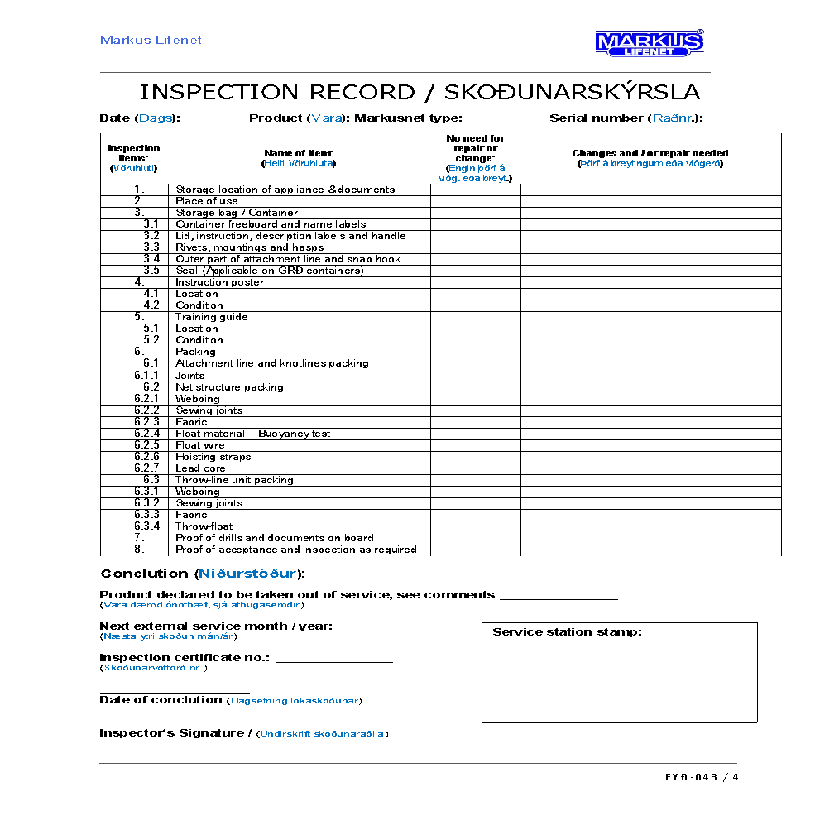
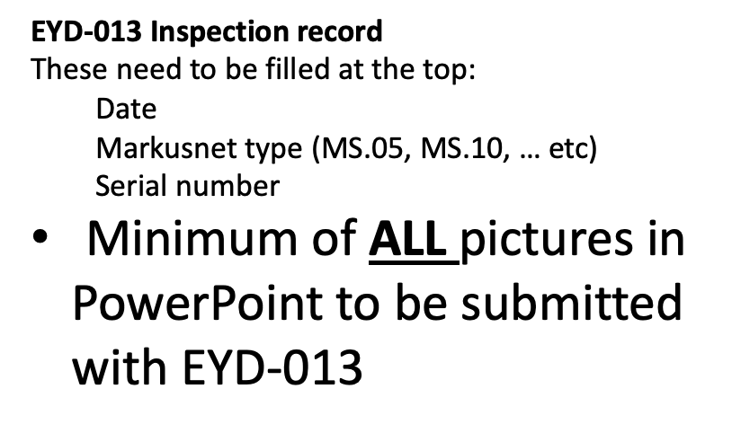
Overview of EYD 043

